Slide 1
PROJECT
WEB TECHNOLOGY
A BLOG WEBSITE
Students:
Ngô Hồng Quốc Bảo B1809677
Nguyễn Đặng Hạnh Nhân B1809713

Slide 2

1. FUNCTIONS
FUNCTION | PRIVILEGE | DESCRIBE
Register | Visitor | Create a new account
Login | Admin | Sign up to have privilege of an admin
Search posts | Visitor, Admin | Find a post by entering a post’s name/ category
View posts | Visitor, Admin | View all the posts updated by some authors
View post’s details | Visitor, Admin | View the specific information of a post in detail
Related posts | Visitor, Admin | See another posts which have same author
Comment management | Visitor, Admin | Upload/ delete their comments on each post
Profile management | Admin | Update the profile
Post management | Admin | Create/ update/ delete the posts.
Sign out | Admin | Visitor’s mode

Slide 3
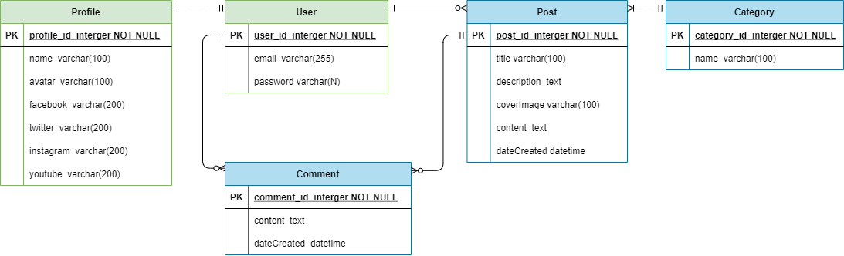
2. DATABASE STRUCTURE

Slide 4
3. TECHNICALITY
Frameworks / Libraries: Django v3.2.8, Bootstrap, jQuery v3.5.1, CKEditor5
Languages: Python v3.9.6, JavaScript
Technology: Ajax

Slide 5
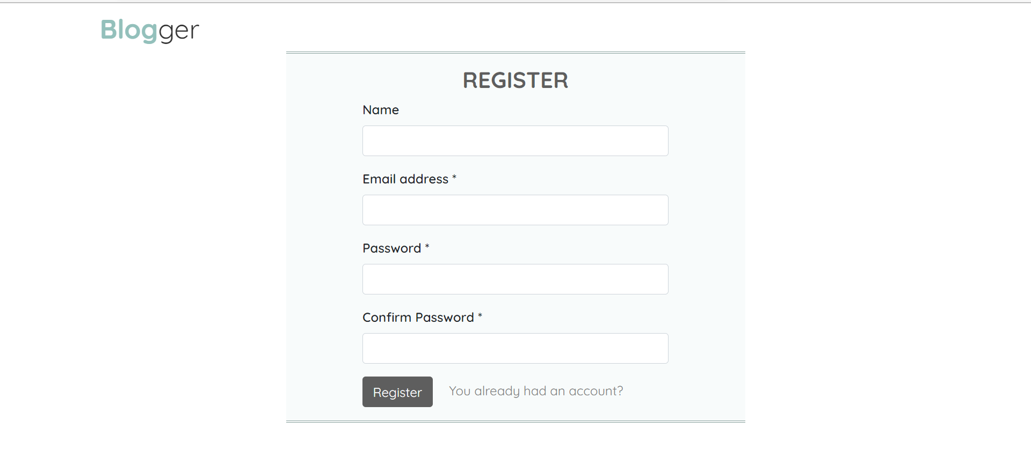
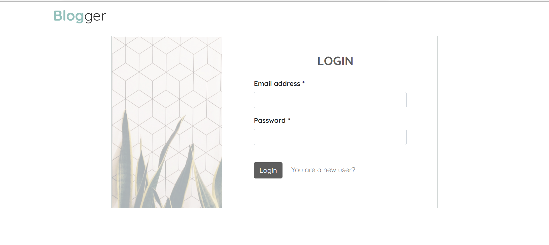
4. RESULT
Figure 1: Authentication page

Slide 6
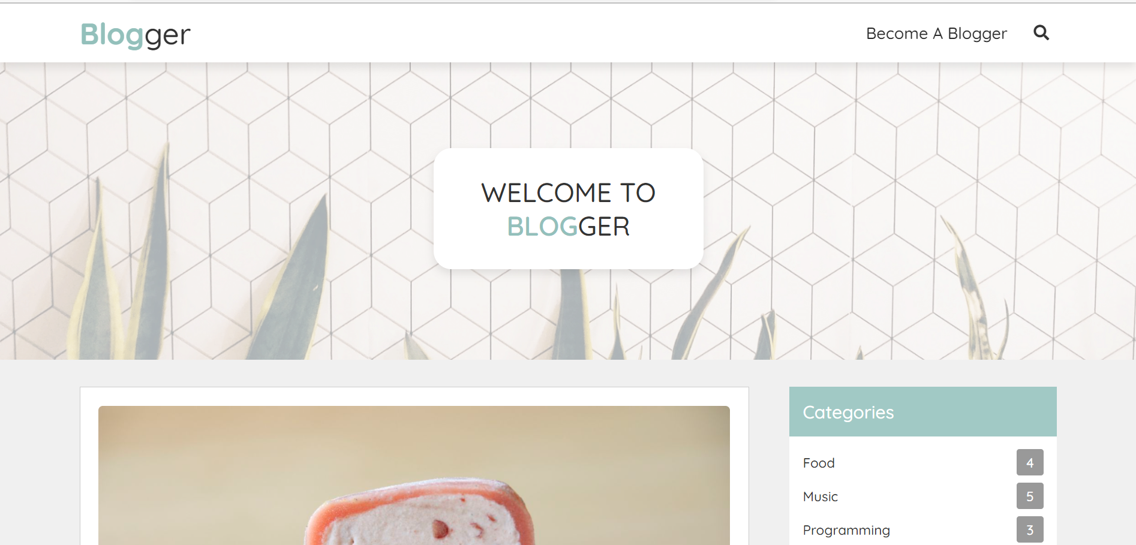
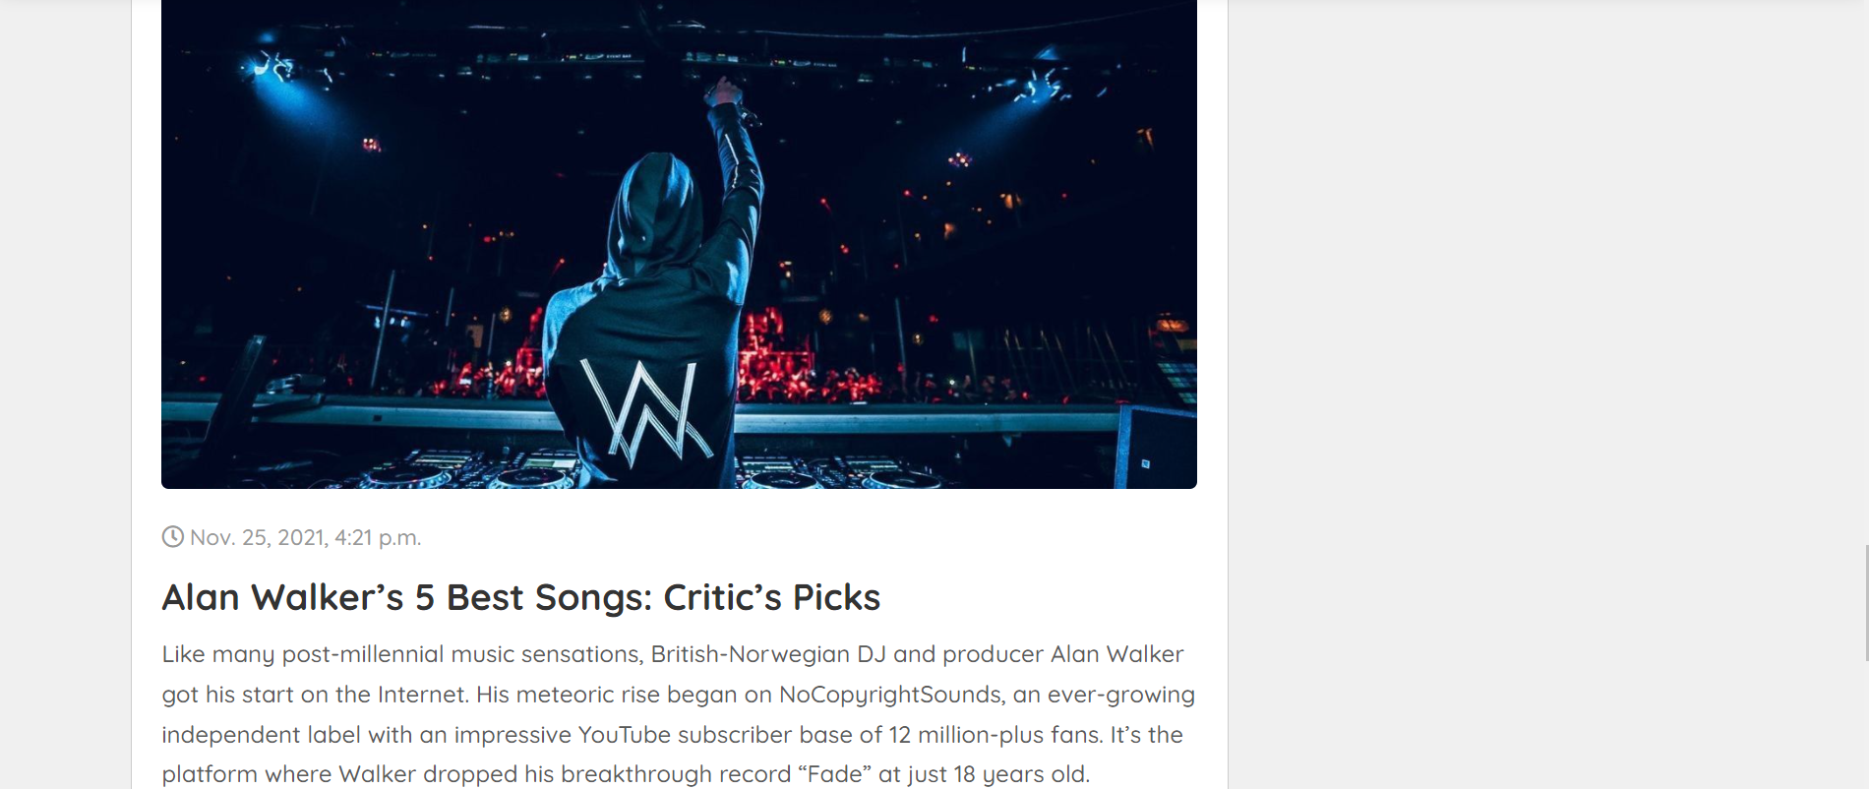
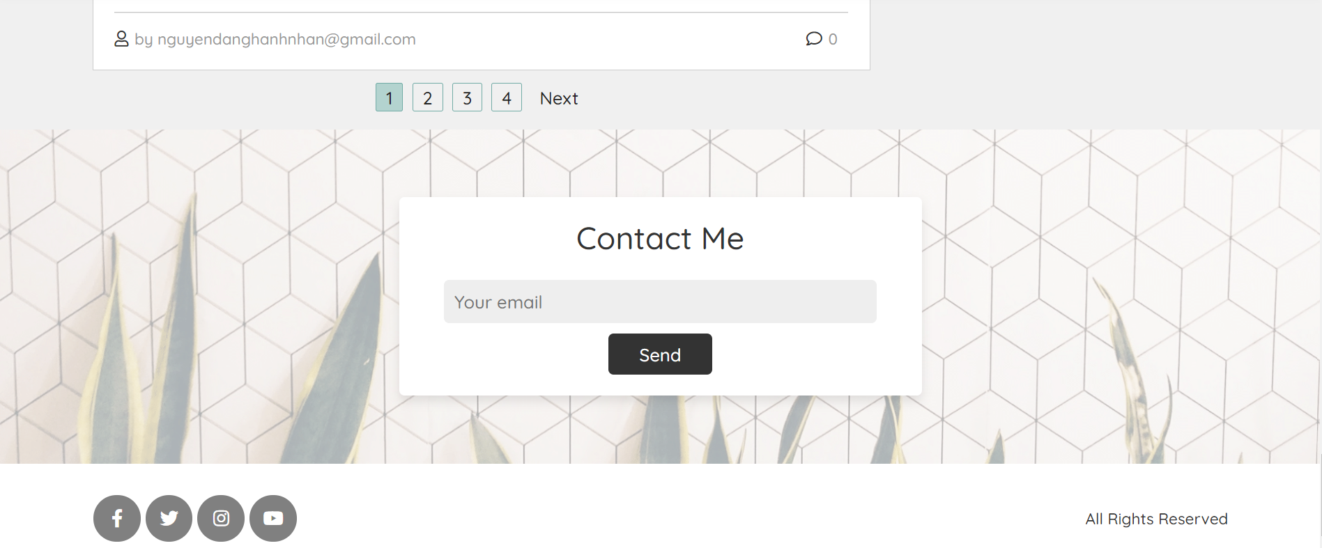
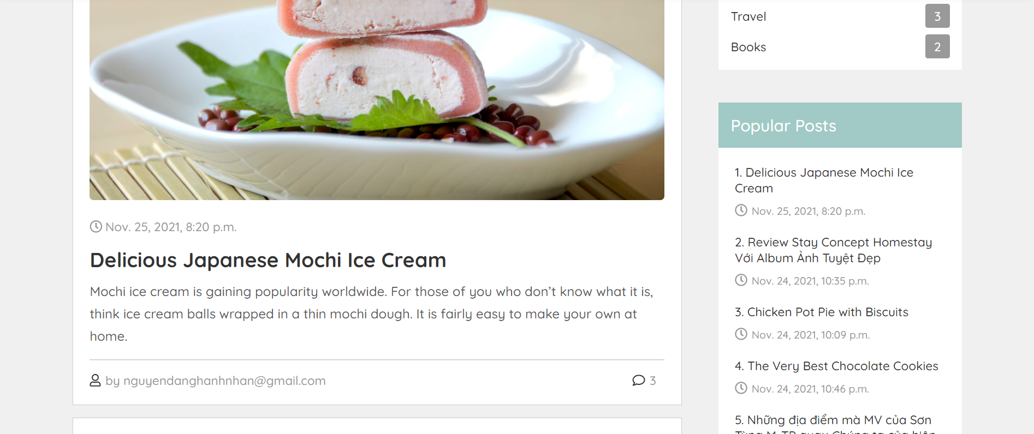
4. RESULT
Figure 1: Top of the homepage
Figure 2: Rest of the homepage

Slide 7

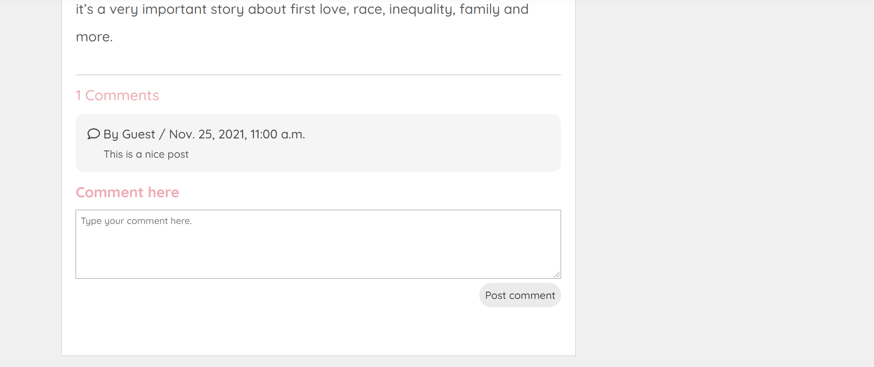
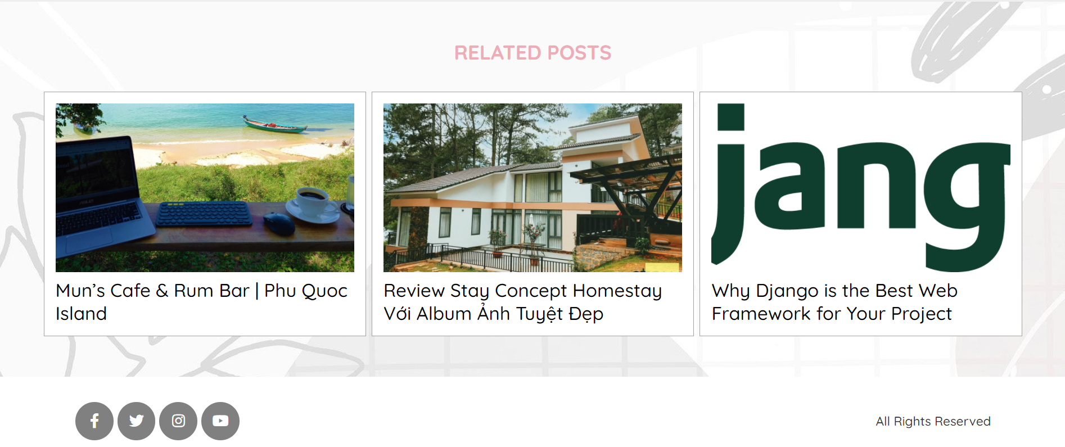
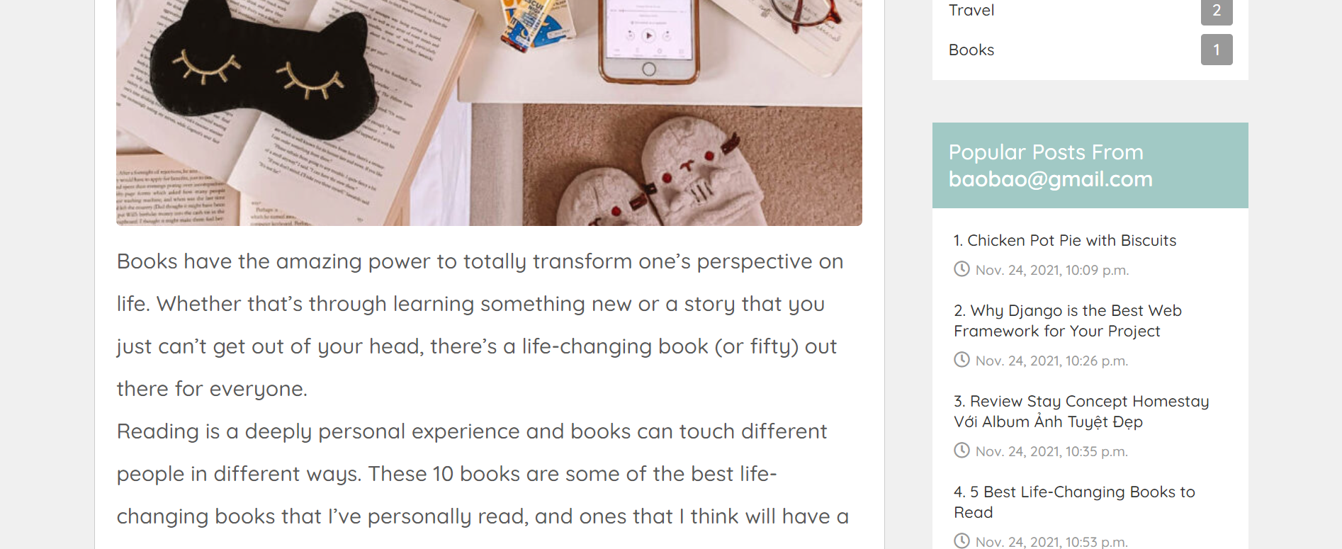
4. RESULT
Figure 1: Top of the post’s detail page
Figure 2: Rest of the post’s detail page

Slide 8
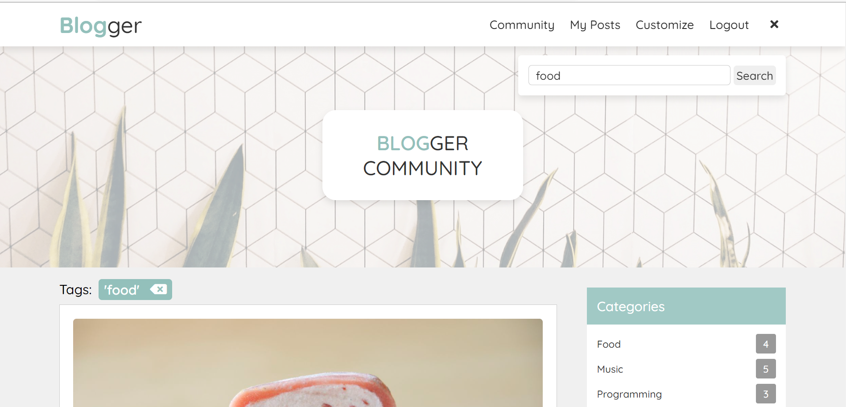
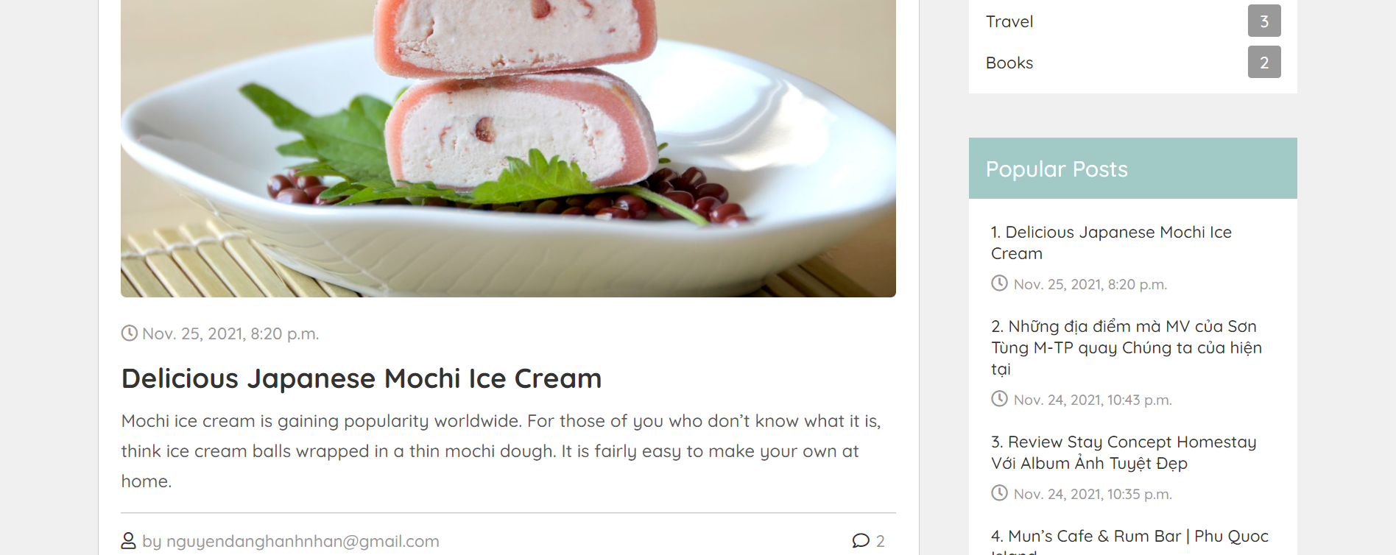
4. RESULT
Figure 1: Search’s result page

Slide 9
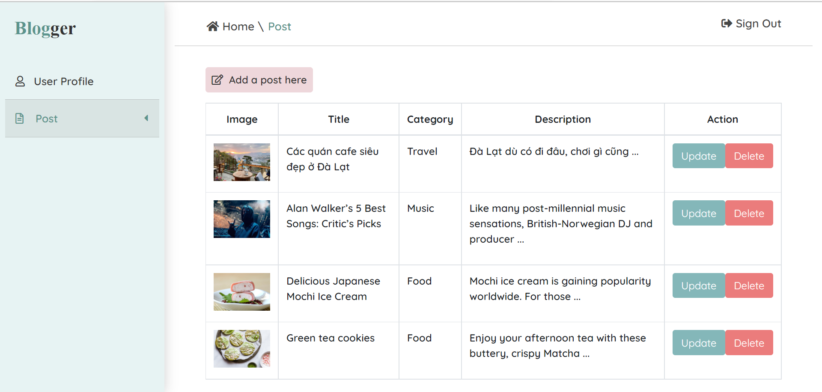
4. RESULT
Figure 1: Post’s management page

Slide 10
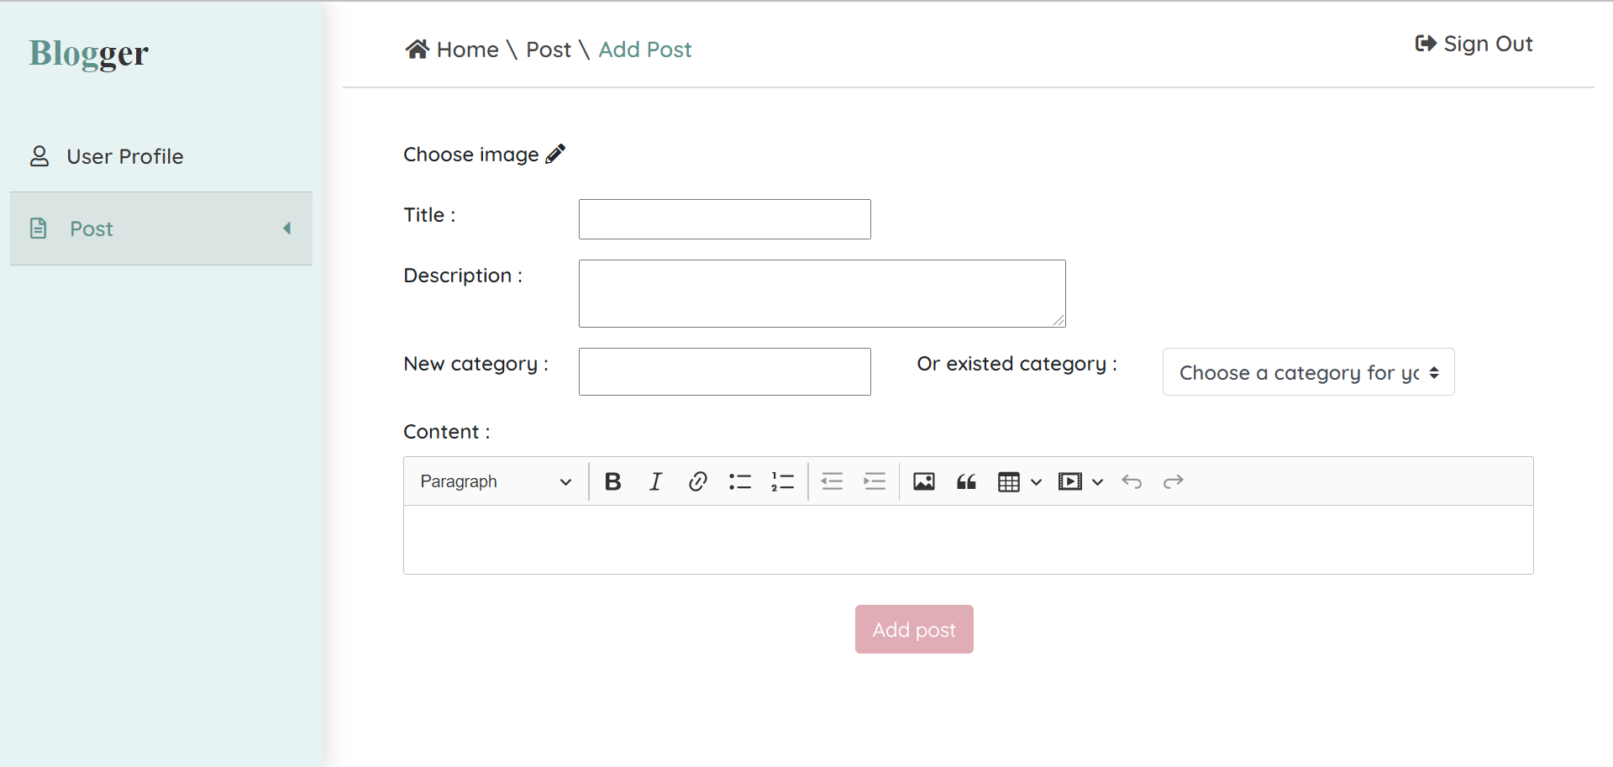
4. RESULT
Figure 1: Create post page

Slide 11
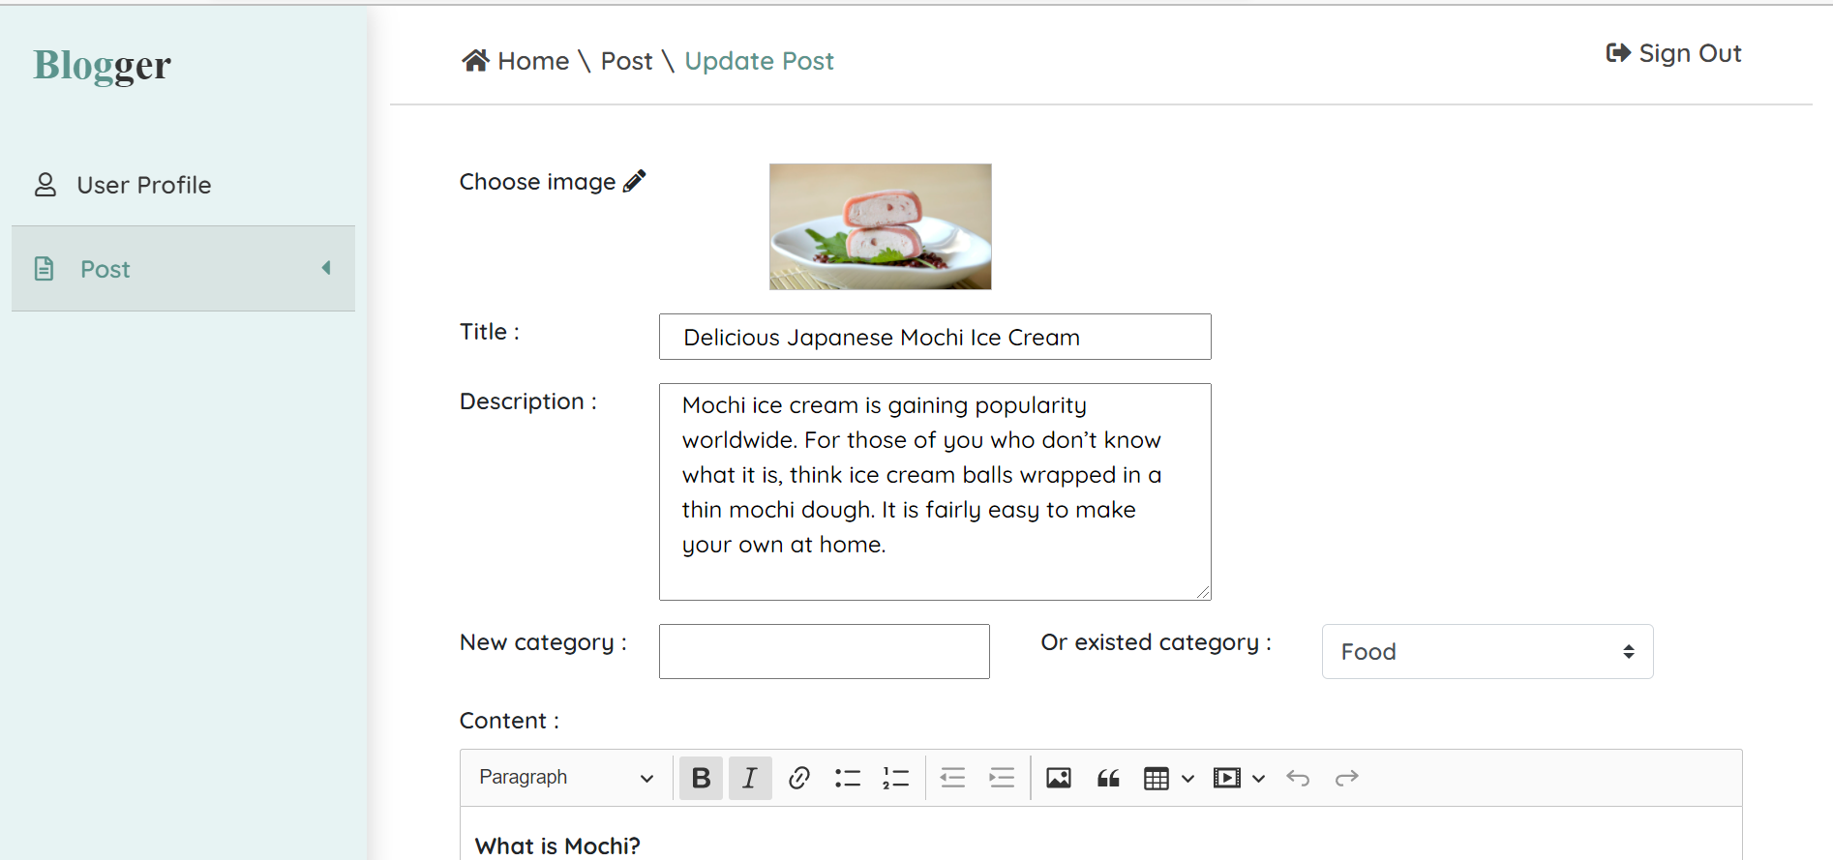
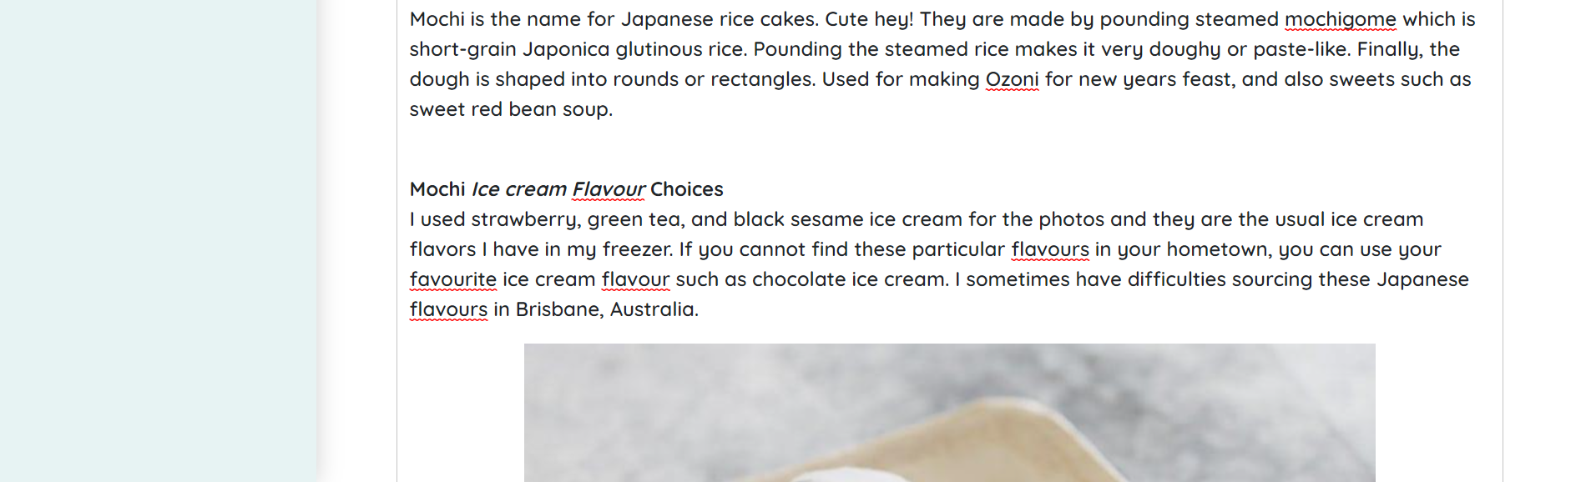
4. RESULT
Figure 1: Update post page

Slide 12
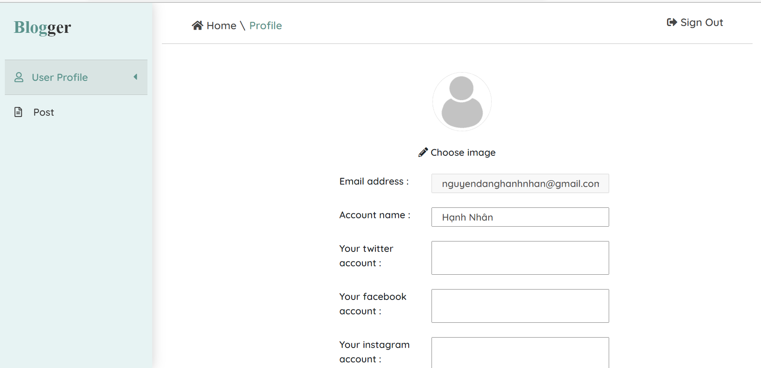

4. RESULT
Figure 1: Update profile page

Slide 13
PROJECT
WEB PROGRAMMING
THANK YOU.

